Slide 1
Earning College Credit while in
High School
Anderson high school
February 4, 2020

Slide 2

College Credit Options at Anderson High School
ACC Dual Credit
UT ONRAMPS
Advanced Placement
International baccalaureate

Slide 3

What is UT OnRamps?
OnRamps students are enrolled in both a high school course led by a high school teacher and a distance college course led by a college instructor of record.
The student receives a high school grade from the high school teacher and a college grade from the college instructor of record, as well as ongoing feedback and support throughout the course.
Of the many benefits to this dual enrollment model, the student is empowered to take on the role of college student and is held to the same standards of leading universities.
The number and type of assignments for the college course will vary based on the course. Each course syllabus will contain information specific to that course.

Slide 4

What OnRamps classes are offered at AHS?
English IV
US History
Statistics
Physics 1 & 2

Slide 5

AP (Advanced Placement)
Started in 1955
College-level curricula and examinations for high school students
ANYONE can take an AP exam – do not have to be in an AP course
Exams are administered in spring and credit varies by University

Slide 6
AP (Advanced Placement)
Honors courses (formerly Pre AP) can be taken freshman/sophomore year to prepare for AP level classes
AP level classes typically junior/senior year except World History
About 1300 exams given in May

Slide 7


Slide 8

What is IB?
The International Baccalaureate (IB) Diploma Programme (DP) is a world wide curriculum that was established in 1968 in Geneva, Switzerland. There are 940 DP schools in the U.S., and 2,926 in the world.
Anderson’s IB program was established in 1991, and we are the oldest IB school in central Texas.
The IB Diploma Program is a comprehensive course of study designed for highly motivated students. It is the most rigorous college prep that can be studied at Anderson.

Slide 9
IB at Anderson…
IB Courses are taken in the junior and senior year
Students apply to the program in spring of sophomore year
2 Options:
  IB Diploma Curriculum A two year course of study made up of six subject groups and the DP core
  Select IB Courses Students elect to study at least two higher level IB courses taken over the junior and senior years.

Slide 10
WHAT is ACC Dual Credit?
Allows eligible high school students (9-12) residing in the ACC service area to enroll in college level classes
Students receive 12 individual course attempts with waived tuition/fees. There MAY be costs for textbooks and other materials. Subject to change by ACC Board of Trustees!
Dual Credit / tuition & fees waiver is only applicable to courses on the ACC Core Curriculum, a Workforce Degree/Certificate, and Foreign Languages (to include ASL)
Classes are taught at Anderson by ACC professors. Students may also take courses online or at ACC campus year-round.

Slide 11
Types of Dual Credit
DUAL CREDIT
CO-ENROLLMENT
Students complete a college course that meets ISD-approved graduation requirements (ex. HIST-1302 or GOVT-2305).
Students complete a college course and only receive college credit…
The class is not needed for high school graduation (ex. GOVT-2306).

Slide 12
WHO is Eligible for ACC Dual Credit?
Students who have successfully completed 8th grade and attend either a public, private, charter, or home school.
Students who have passed the appropriate sections of the State of Texas-approved college readiness assessment test (TSI-A) or submit acceptable exemption scores.
Students who have received permission from their parent/guardian and high school counselor/designee.

Slide 13

What ACC Dual Credit classes are offered at AHS?
English IV (Seniors only)
US Government
Economics
US History (1877-present)
Texas State & Local Government
Strategies for College Success
US History (Pre-1877)
Engineering Tech Certificate classes (Programming, College Algebra, AC/DC Circuits – see counselor for more information)

Slide 14
WHERE are ACC Dual Credit classes Offered?
Students may take classes at their high school campus before, during, and after the school day (where offered).
DC Students may also take classes at any ACC Campus, Center location, or via Distance Learning (online).

Slide 15
WHY take Dual Credit Classes?
Save $$$ (potentially 1yr+ of college!).
Earn both high school and college credit.
Gain college-level experience while in high school.
Stand out on college admission applications.
Graduate from college early or reduce semester course load.

Slide 16
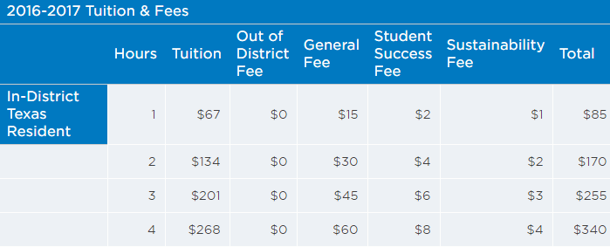
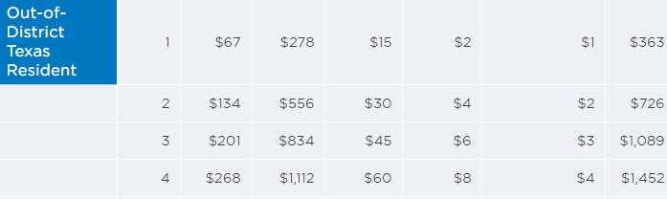
2018-2019

Slide 17
College vs High School…
Students pay for textbooks/required materials.
College classes can/will require a different level of work than high school classes. Also, different structure!
Course content and student expectations are not altered in any way to accommodate students under 18 years of age - College courses & Instructors = Academic Freedom
Students are responsible for dropping/withdrawing from classes or they will receive a grade.
Not attending class will not automatically drop you!

Slide 18
College vs High School…
ACC information goes directly to the student via the students ACCmail account.
Dual Credit students have access to all the services provided by ACC, i.e. Learning Labs, Libraries, Testing Centers, etc.
Parents are not automatically entitled to see student records, including absences, grades, and course progress due to federal privacy law (FERPA).
ACC issues final letter grades only (A, B, C, D, F, and W). Transcribed to AHS as A=96, B=86, C=76, D=70, F/W=NC

Slide 19
Student Success & Satisfactory Academic Progress (SAP)
Student success is extremely important. College records are permanent and will follow students to colleges and universities upon high school graduation.
Students must maintain a minimum cumulative GPA of 2.0 (“C” or better in all ACC classes) -and- they must complete 67% of all classes attempted (No F’s or W’s)
Students who do not meet SAP may not be eligible for financial aid upon high school graduation until GPA and Completion Rate meet federal requirements.

Slide 20
The Good News!
Dual Credit students do better than traditional students in terms of mean GPA and have better persistence from semester-to-semester.
ACC credits transfer seamlessly to Texas public colleges and universities.
U.S. History at ACC = U.S. History at UT, TAMU, TX State, etc.
ACC credits can transfer widely to Texas private colleges, as well as out-of-state public & private colleges/universities.

Slide 21
More Good News!
From the Dual Credit at Texas Completes Cadre Colleges - October 2018:
ACC's Dual Credit Program…
Ranked #2 in the state on First Year Persistence Rates at Universities of dual credit students who started at ACC
Ranked #1 in First Year GPA at Universities of dual credit students who started at ACC
Ranked #2 in State-wide Graduation Rates at Universities of dual credit students who started at ACC

Slide 22
In Summary…What’s the Difference?
IB/AP
OnRamps
ACC Dual Credit
HS course
Taught by HS teacher at AHS
College Board/ IB curriculum
Credit-by-exam (AP /IB test)
Cost for test
Must earn a certain score to potentially receive college credit
No TSI required
HS course
Taught by HS teacher and supported by UT faculty at AHS
Students can earn credit for HS course only or both HS and college credit
If college credit earned it is denoted on a UT transcript
No TSI required
College course
Taught by college professor
Students can earn HS and college credit or only college credit
Student’s college credit is denoted on an ACC transcript
Classes are at AHS, ACC campus or online
TSI/College readiness scores required

Slide 23
For more information…
ACC Dual Credit: Cathy Painter
catherine.painter@austinisd.org
512.414.7936
IB: Jill Spencer
jill.spencer@austinisd.org
512.414.7951
UT Onramps & AP:
See your student’s Academic Counselor

